Slide 1
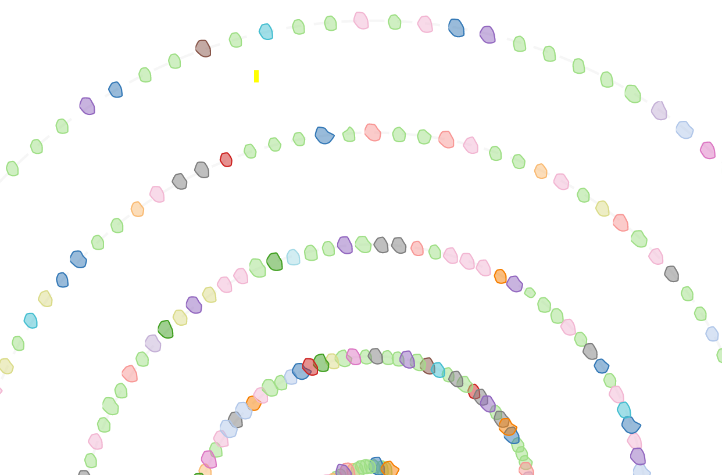
SpiralLayout
Weekly report

Slide 2
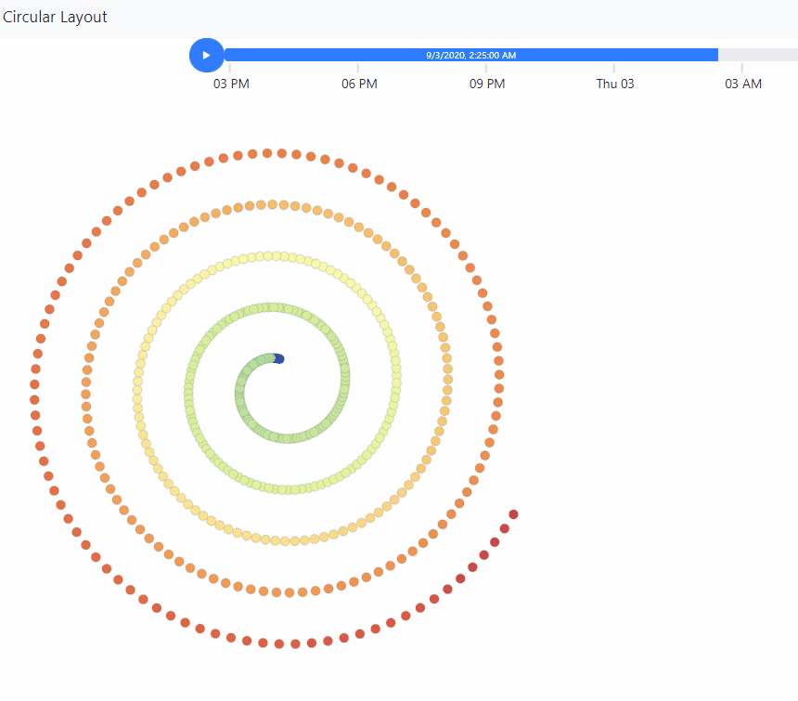
SpiralLayout
Compute
Color by metrics value (e.g: Temperature, Fan speed, etc.)

Slide 3
SpiralLayout
Historical data
https://idatavisualizationlab.github.io/HPCC/spiralLayout/index.html

Slide 4
SpiralLayout
Historical data
https://idatavisualizationlab.github.io/HPCC/spiralLayout/index.html
Realtime
https://idatavisualizationlab.github.io/HPCC/spiralLayout/index.html?mode=realTime

Slide 5
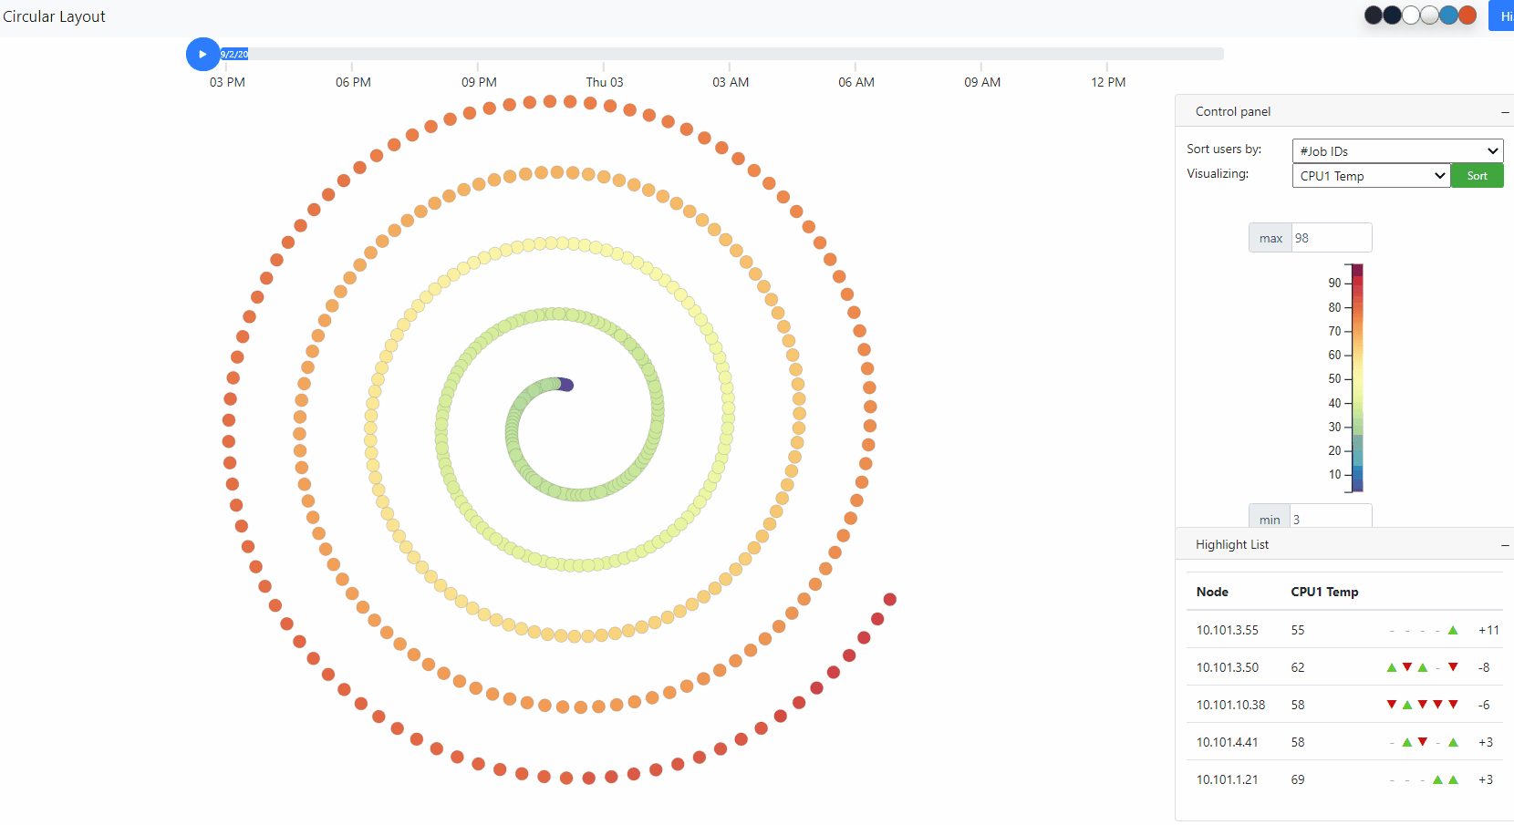
SpiralLayout
Sep 2, 2020 2:50:00 PM – Sep 3, 2020 2:50:00 PM
Duration: 24 hours
Interval: 5 minutes
#Timesteps: 288
#Users: 57
#Computes: 467
Nodes have high changed value

Slide 6
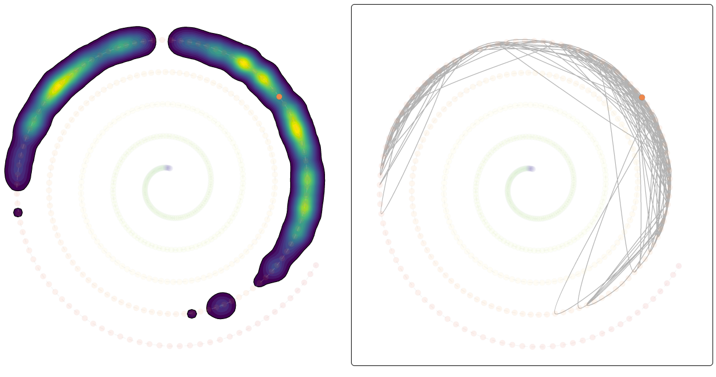
SpiralLayout
Trajectory
Metric : CPU1 Temp
Node: 10.101.2.60
Low
Density Contour
Line connection
High

Slide 7
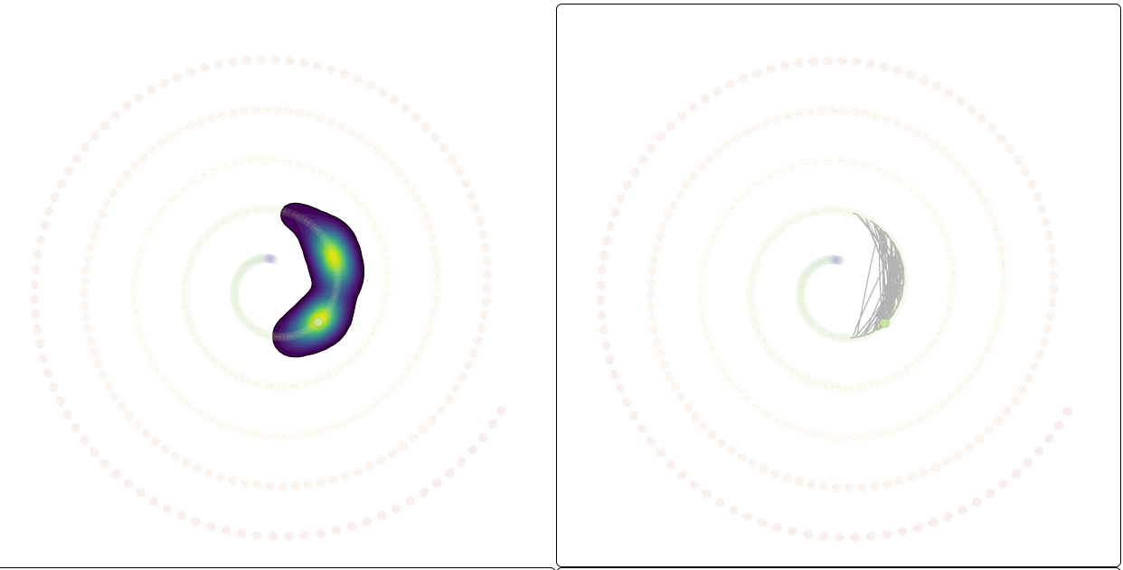
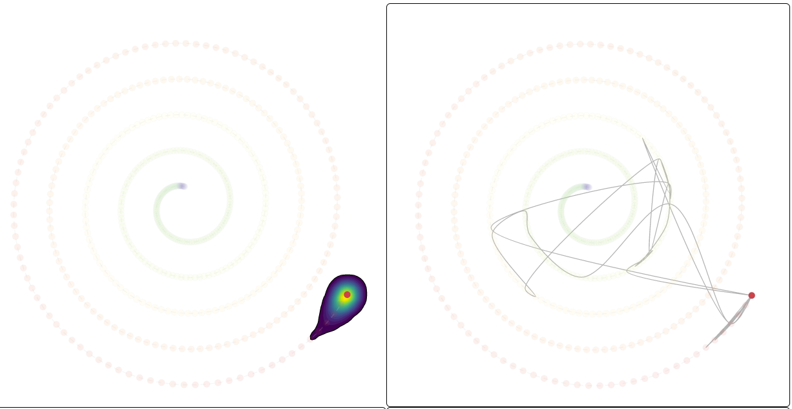
SpiralLayout
Trajectory
Metric : CPU1 Temp
10.101.2.60
10.101.5.1
10.101.4.32

Slide 8
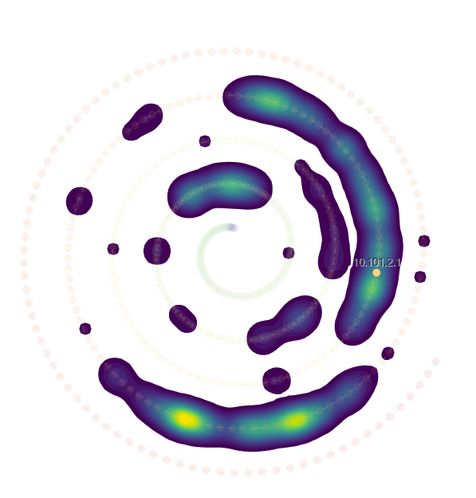
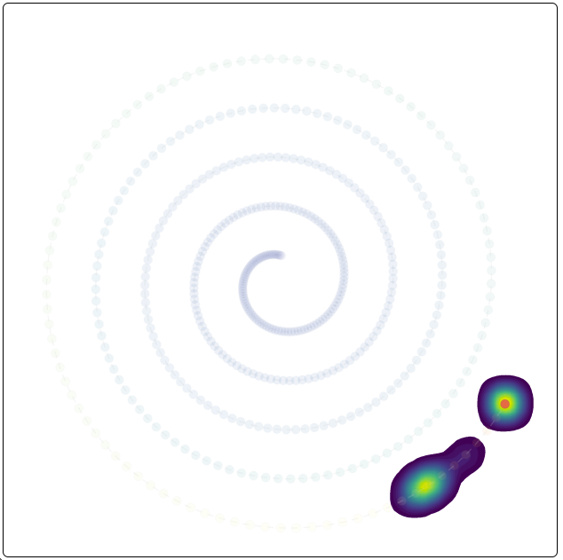
SpiralLayout
Node: 10.101.2.1
CPU1 Temp
Memory Usage

Slide 9
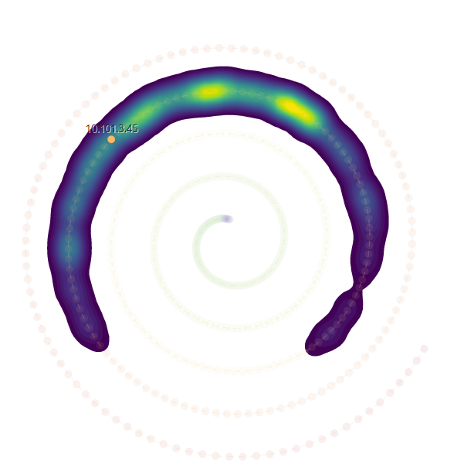

SpiralLayout
Node: 10.101.3.45
CPU1 Temp
Memory Usage

Slide 10
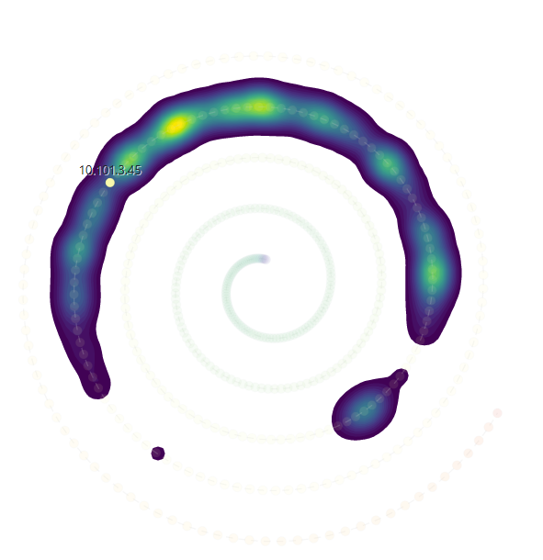
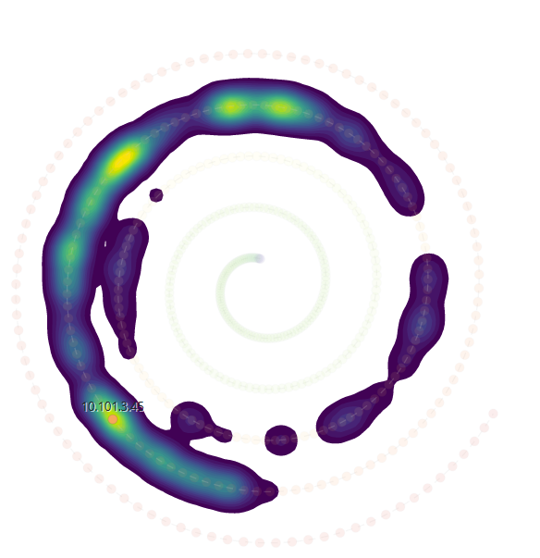
SpiralLayout
Node: 10.101.3.45
CPU1 Temp
Memory Usage
CPU2 Temp
Power consumption

Slide 11
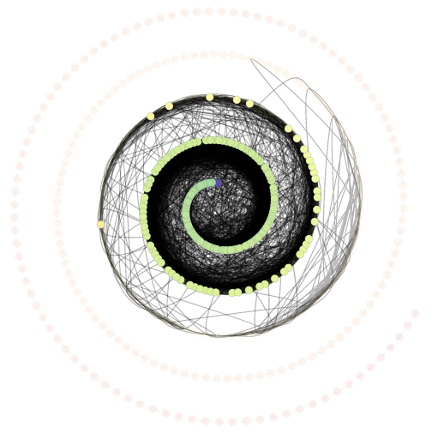

SpiralLayout
User: esowell
CPU1 Temp

Slide 12



SpiralLayout
User: esowell
CPU1 Temp
Memory Usage
CPU2 Temp
Power consumption

Slide 13
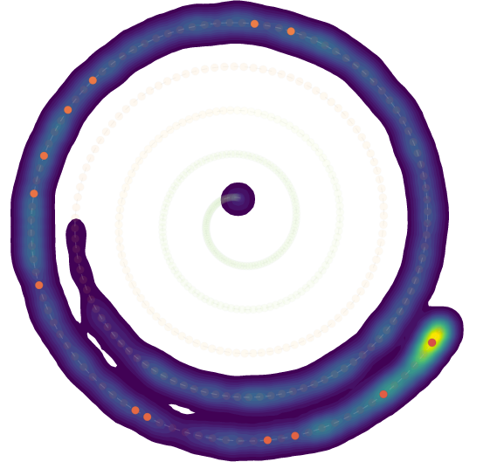
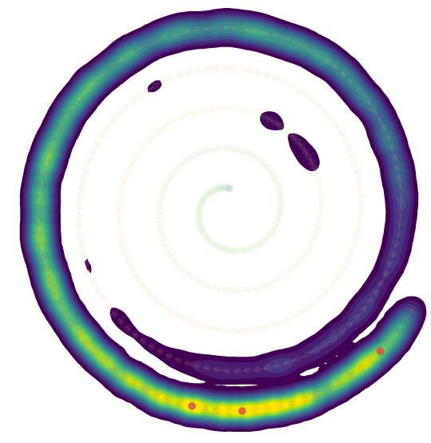
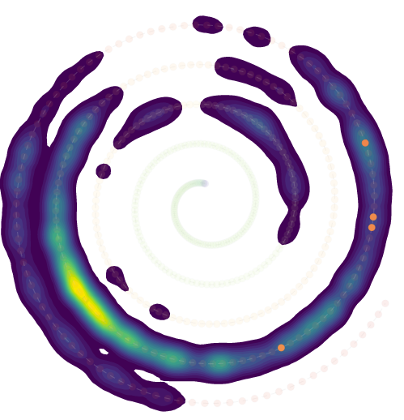
SpiralLayout
Power consumption
esowell
fmolajaf
rmanser
ddocimo

Slide 14


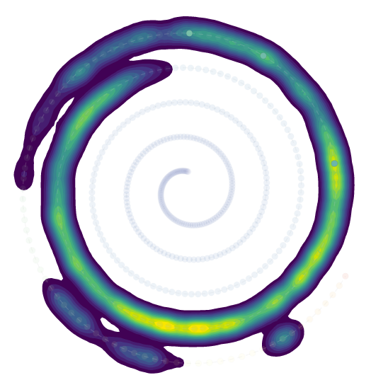

SpiralLayout
Memory usage
esowell
fmolajaf
rmanser
ddocimo

